Slide 1
Semantic UI ?
History
C
Installation
Elements
Modules
Bootstrap Vs Semantic UI
B
Index-1
A
Lightning Talk by→
Vanchhit Khare
Front-End Engineering
Section-II
Semantic UI
Components in Semantic UI
Index-2
Use of Semantic UI
Less & Jquery
Collection
Views
Pros
Cons

Slide 2
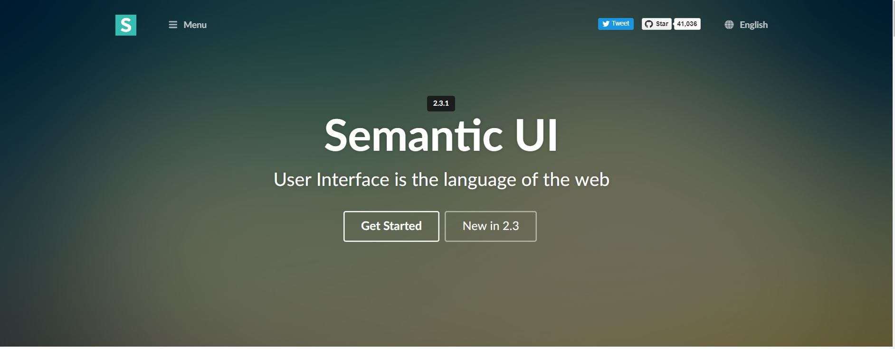

Semantic-UI Details
* Started in 2013
Semantic UI is a modern front-end development framework, powered by LESS and jQuery. It has a sleek, subtle, and flat design look that provides a lightweight user experience.

Slide 3
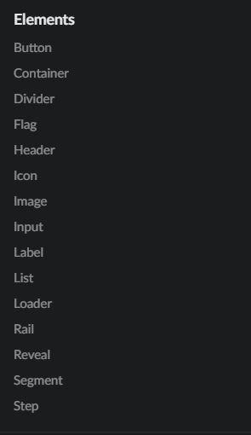
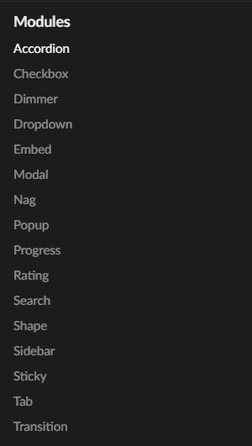
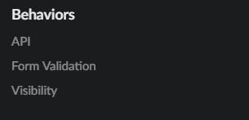
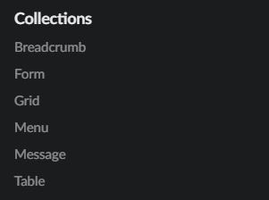
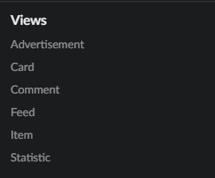
Components in Semantic UI

Slide 4
Installation
● Install NodeJS
● Install Gulp
● Install Semantic UI
● Include in Your HTML
● Include in Your HTML
<link rel="stylesheet" type="text/css" href="semantic/dist/semantic.min.css">
<script src=".../2.1.3/jquery.min.js"></script>
<script src="semantic/dist/semantic.min.js"></script>

Slide 5
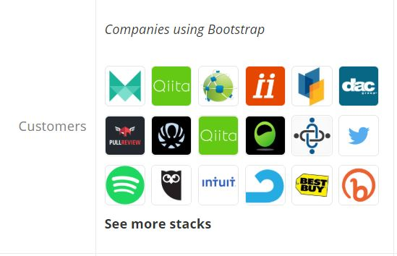
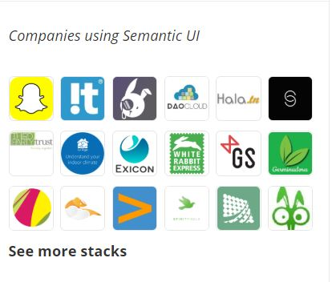
Companies Comparison
Bootstrap is known for being responsive, consistent, and flexible. It’s widely used and well documented, and fans appreciate its responsiveness.
Semantic UI is easy to use and elegant, according to fans.

Slide 6
Semantic UI Pros
Load only the components you need.
The elements offer a huge amount of customization, far beyond a framework like bootstrap
It's semantic
Beautifully designed
It'll have almost any UI component/element you may think of for your project
Well documented
Official support for third-party applications

Slide 7
Semantic UI Cons
Very large file size
Not for beginner developer/unfamiliar with Javascript
Buggy
Small number of classes

Slide 8
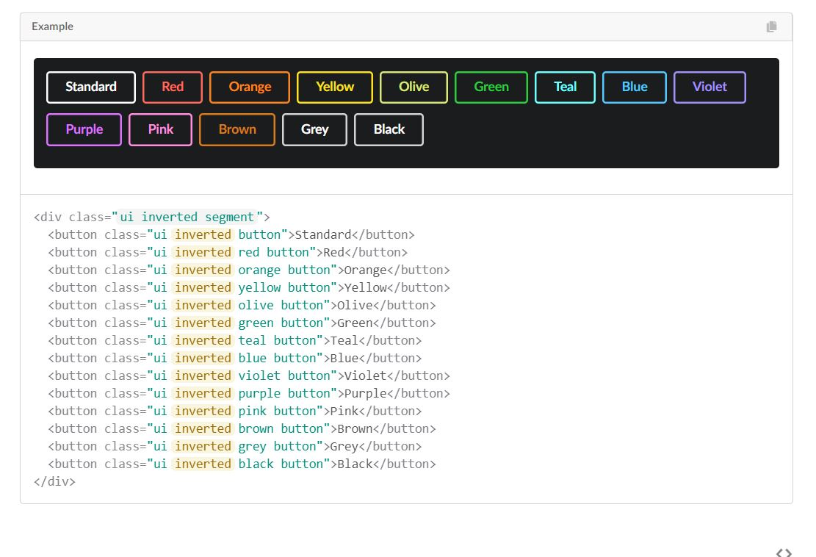
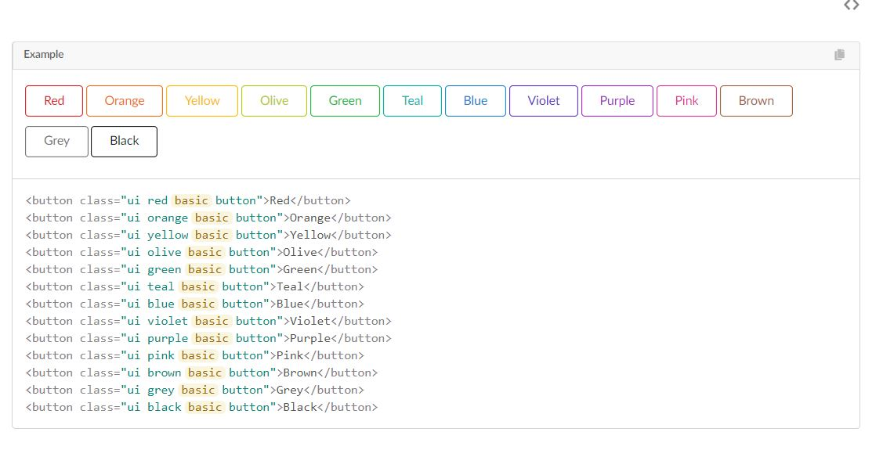
Elements
Buttons

Slide 9
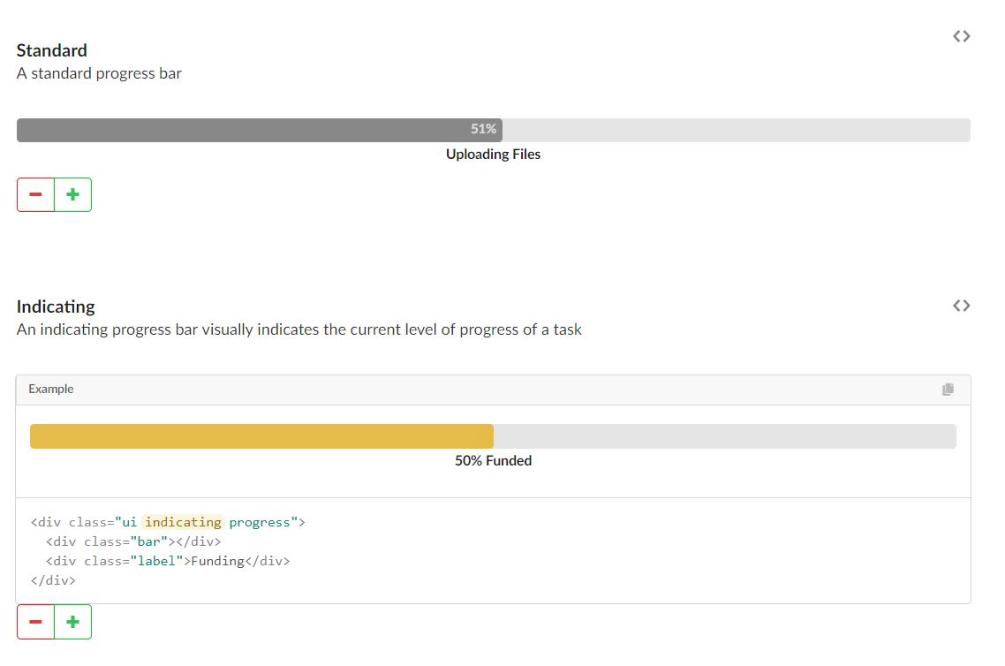
Modules
Progress-BAR

Slide 10
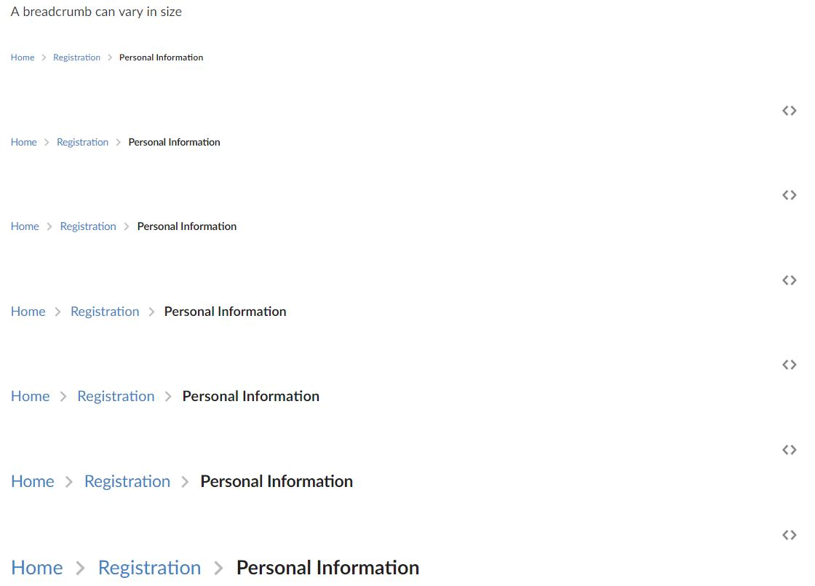
BreadCrumb
<div class="ui mini breadcrumb">
<a class="section">Home</a>
<i class="right chevron icon divider"></i>
<a class="section">Registration</a>
<i class="right chevron icon divider"></i>
<div class="active section">Personal Information</div>
</div>
Tiny
small
large
huge
big
massive

Slide 11


Slide 12
References
https://semantic-ui.com/
https://www.upwork.com/hiring/development/twitter-bootstrap-vs-semantic-ui/
https://stackshare.io/stackups/bootstrap-vs-foundation-vs-semantic-ui
https://codeburst.io/evaluating-css-frameworks-bulma-vs-foundation-vs-milligram-vs-pure-vs-semantic-vs-uikit-503883bd25a3
https://www.slant.co/versus/520/5087/~semantic-ui_vs_html5-boilerplate

